Slide 1
The Power of Physics Estimation
Tom Murphy
UCSD Physics/CASS

Slide 2
Inspired By…
Famous physicists like Fermi and Feynman frequently formulated fantastic feats of estimation
optional: “estimation” → “finagling figures”
Best course I ever took: Order of Magnitude Physics at Caltech
team-taught by Peter Goldreich and Sterl Phinney
Estimation and Scaling in Physics (UCSD Phys 239)
team-taught by Fuller, Diamond, Murphy spring 2010, spring 2012

Slide 3
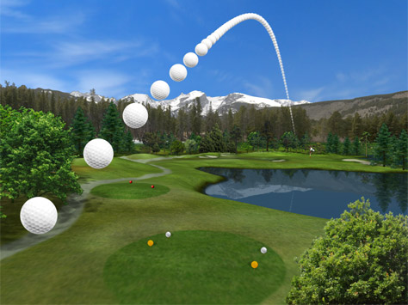
Our Trajectory Today
Fermi problems
Materials properties
Some time in the clouds
Fuel economy of cars
Energy scales (biofuels, waste, storage)
Climate Change

Slide 4
Color Coding to Clarify
Black: generic
Orange-brown italics: emphasis
Red: assumptions
Blue: constants/knowledge
Purple: results
A note on numbers:
π = 3 = sqrt(10) = 10/3
2 ≠ 3, but 8 ≈ 9
c, e, h, k_{B}, m_{p}, m_{e}, σ, G, N_{A}, μ₀, ε₀, R_{E}, M_{E}, r_{AU}, etc. by memory

Slide 5
Fermi Problems
How many piano tuners in Chicago?
How many molecules from Julius Caesar’s last breath do you draw in on each breath?
How far does a car travel before a one-molecule layer is worn from the tire?
How many laser pointers would it take to visibly illuminate the Moon?
How heavy is a typical cloud?
Book: Guesstimation (by Weinstein and Adam)

Slide 6
Example Fermi Problem
How many kids are laughing so hard right now that milk (or cultural equivalent) is streaming out of their noses?
7 billion people in world
life expectancy: 60 years
vulnerable age: 4 to 10 → 10% of life → 700 million at risk
half of people have had this experience → 350 M at risk
once-in-lifetime event, 10 sec duration → 10/(6×π×10⁷)
350 M × 0.5×10⁻⁷ ≈ 20

Slide 7
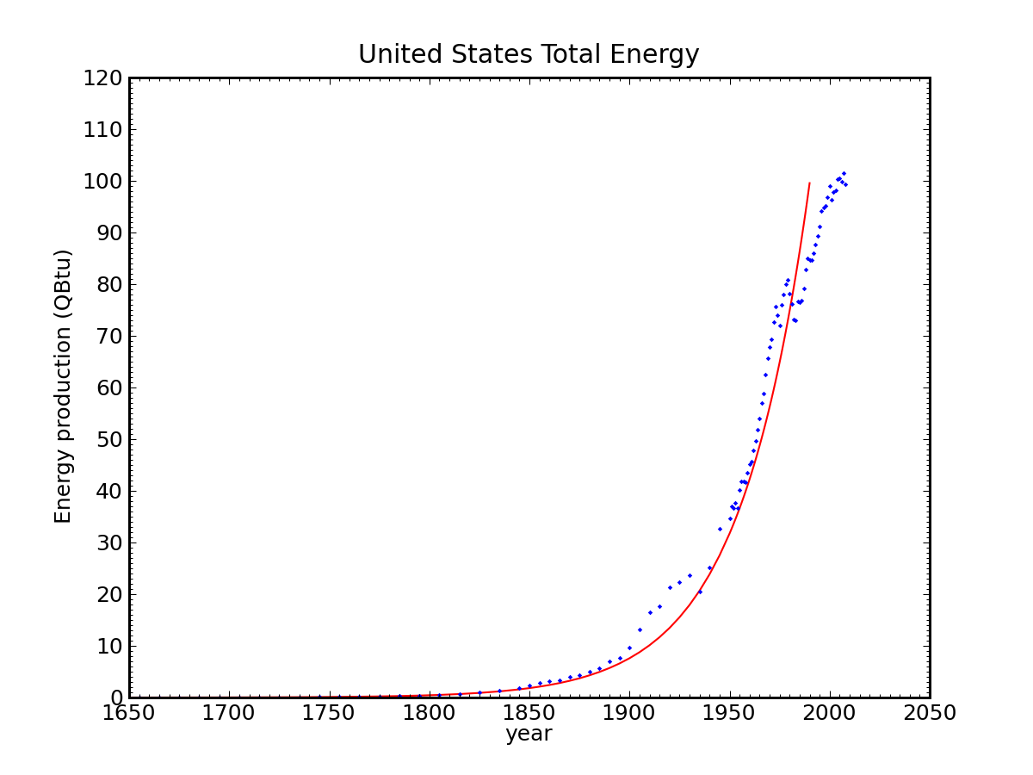
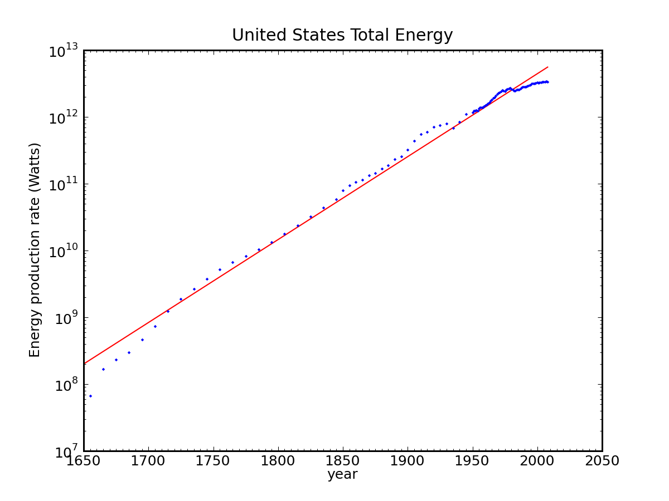
Fermi Approach Applied to Exponentials
logarithmic plot of the same
1650
2050
1650
2050
Sum of all forms of energy used in the U.S. (fossil fuels, nuclear, hydro, wood, etc.)
Red curve is exponential at 2.9% per year growth rate
World is at 12 TW now; pick 2.3% rate, mapping to 10× per 100 yrs.

Slide 8
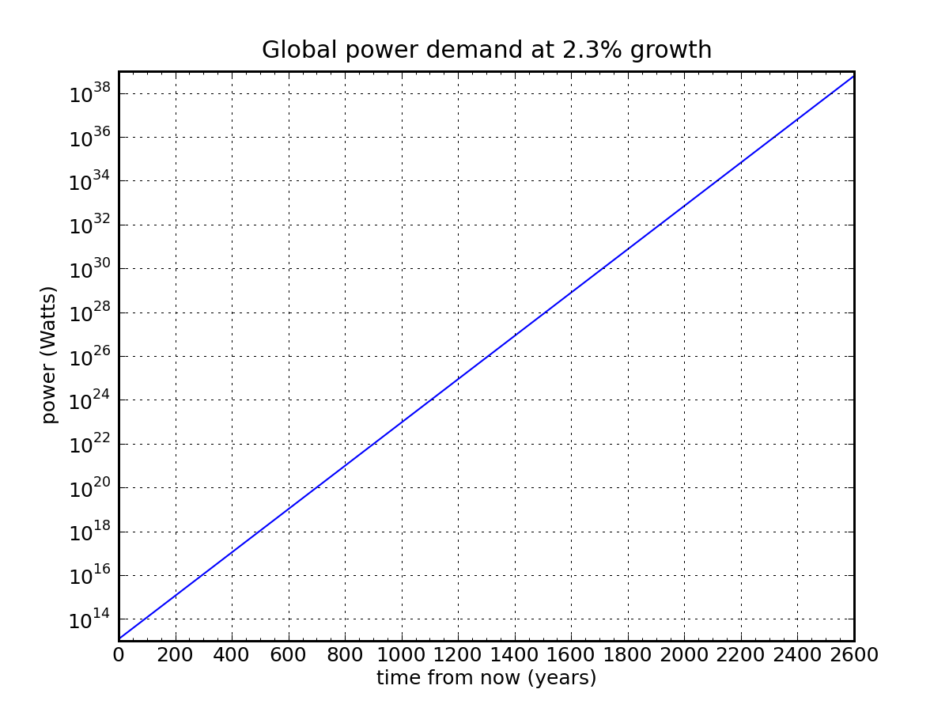
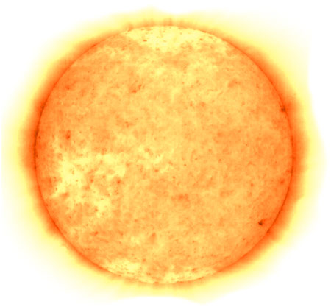
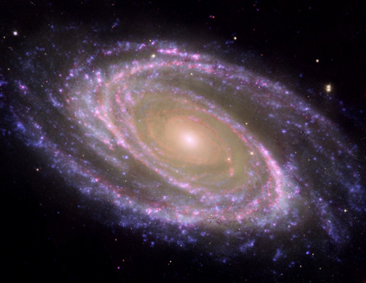
Extrapolating at 10× per Century
power output of the entire Milky Way galaxy
power output of sun
2500 years
1400 years
solar power reaching Earth’s upper atmosphere
all solar
solar power reaching Earth’s land
land
421 yr
336 yr
12 TW today
(1.2×10¹³)

Slide 9
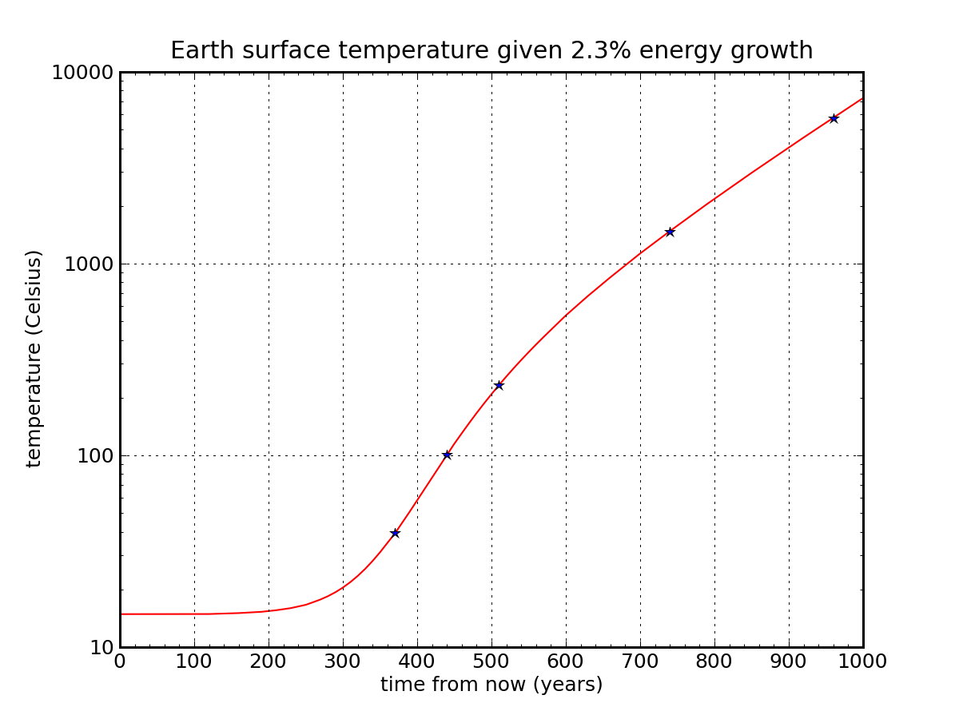
Waste Heat Boils Planet (not Global Warming)
sun surface temperature
thermodynamic consequence of
arbitrary energy technology on Earth
steel melts
paper burns
water boils
body temperature
global warming?
Straightforward application of σT⁴ radiative disposal of heat

Slide 10
Materials Properties
Heat Capacity
Thermal Conductivity
Strength of materials
Thermal Expansion
All from knowledge of bond strength (eV scale), atomic number, density, kT at room temperature (1/40 eV)

Slide 11
Heat Capacity
3/2 kT per particle
derivative is just 3k/2, Joules per Kelvin per particle
Want J/K/kg
1 kg has 1000N_{A}/A particles
c_{p} = 1500×N_{A}×k/A ≈ 12000/A J/K/kg
Note N_{A}×k = 6×10²³ × 1.4×10⁻²³ ≈ 8 (R = 8.3 J/mol/K ideal gas constant)
Since most of our world has A ≈ 10−50, c_{p} ≈ 200−1000 J/K/kg
Can get thermal conductivity for gas using mean-free-path and relating to diffusion equation

Slide 12
Mechanics of Solids: Potential
ε
approximate by quadratic, depth ε,
center at a, width a at E = 0
a

Slide 13
Getting the Elastic Modulus
Associate spring constant with 8ε/a²
Have one spring per area a², so stress (force per area) is
Associate elastic modulus, E, with 8ε/a³
For ε ≈ 1 eV = 1.6×10⁻¹⁹ J; a ≈ 2 Å (2×10⁻¹⁰ m)
can get a from density and atomic number
E ≈ (8×1.6×10⁻¹⁹)/(8×10⁻³⁰) = 160×10⁹ Pa (160 GPa)
right in line with many materials

Slide 14
Drop a Coffee Mug: how many pieces?
Model as cylinder 0.1 m by 0.1 m, t = 0.005 m wall thickness
Volume 0.3×0.1×0.005 = 1.5×10⁻⁴ m³; 2000 kg/m³ → 0.3 kg
From 1 meter, 3 J of energy
f = 10% goes to breaking bonds (W = 0.3 J)
the rest to heat in ringing pieces
kinetic energy of pieces
Number of bonds broken: W/ε
Area per bond ≈ a²
Area of fractured zone: Wa²/ε
A ≈ (0.3×4×10⁻²⁰)/(1.6⁻¹⁹) ≈ 7.5×10⁻² m²
fracture length, L = A/t = 15 meters

Slide 15
Coffee Mug, Part 2
Have fracture Length, L; say it breaks into N square chunks, side length l
Each square has 2l length of unique breakage it can claim
don’t want to double-count
2Nl = L ≈ 15 m
Total mug area is Nl² = (0.3 m)×(0.1 m) = 0.03 m²
Solve for l = (0.03 m²)/(7.5 m) = 0.004 m → 4 mm
N ≈ 2000

Slide 16
Cloud Computing
How much does a cloud weigh?
Nice illustration of multiple techniques/angles often possible in attacking physics problems
Will work on two aspects:
(over) density of clouds
droplet size

Slide 17
Giant Thunderstorm
Imagine a towering cumulonimbus, 10 km tall (30,000 ft) dumps all of its water
Expect you’ll record something like 1−10 inches of rain
let’s say 0.1 m
Each square meter has 100 kg (cubic meter is 1000 kg)
In 10 km cloud column: (100 kg)/(10,000 m³) = 0.01 kg/m³
about 1% of air density

Slide 18
Bumpy Ride
Airplanes fly into clouds all the time
Sometimes bumpy due to turbulent convection
But no noticeable horizontal deceleration on hitting the wall
Drag force goes like ½ρc_{D}Av², where ρ is density of medium
Drag force is about 5% of lift force (picture aerodynamic flow)
If cloud density were 10% that of air, drag would surge by 10%
would correspond to 0.5% g
sudden onset would be very noticeable
So cloud density << 10% air density
Lift also proportional to density, so vertical more sensitive

Slide 19
Saturation Pressure
Gas phase occupies 22 liters/mole at STP
but vapor pressure exponentially suppressed at temperatures below boiling point (Maxwell-Boltzmann tail)
another view: 100°C saturation pressure is 760 Torr; 20°C → 17.5 Torr
results in density ratio (17.5/760)×(18/29) = 1.5%
less than this at actual temperatures at base of cloud (where condensation begins)
Can go through order-of-magnitude process too
balance rates of entry/exit at liquid/vapor interface using Maxwell-Boltzmann tail

Slide 20
Droplet Size from Terminal Velocity
Particles must be small enough that terminal velocity is very small
pick 10 cm/s (easily overcome by air currents)
Stokes drag regime: F_{d} = 6πρ_{a}νrv
6π is an enemy of the order-of-magnitude scaling approach
r and v are droplet radius and velocity; ρ_{a} and ν are density and kinematic viscosity (≈10⁻⁵ m²/s for air)
Set equal to mg = 4ρ_{w}r³g to get r:
r² = 1.5π(ρ_{a}/ρ_{w})(νv/g) ≈ 6×10⁻³×10⁻⁵×10⁻¹/10 = 6×10⁻¹⁰ m²
r ≈ 25 microns
Check Reynolds number: Re = rv/ν ≈ (10⁻⁵×10⁻²)/10⁻⁵ = 10⁻²
safely under 1, so in Stokes (viscous) regime

Slide 21
Droplet Size from Optical Depth of Fog
Flying in cloud (or driving in heavy fog), might have a 5 m limit to line of sight
mean-free path: λ = 1/nσ
n is space density, σ is cross section (πr²)
using 1% air density, ρ_{c} = 4ρ_{w}r³n ≈ 0.01 kg/m³ → n = ¼(ρ_{c}/ρ_{w})r⁻³
Putting pieces together, r ≈ λ(ρ_{c}/ρ_{w}) ≈ 5×10⁻⁵ m
50 microns

Slide 22
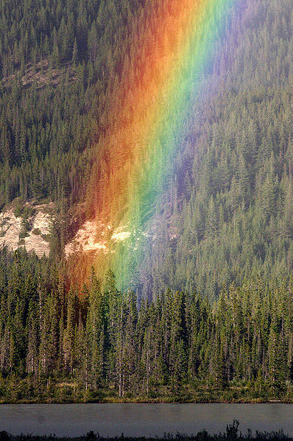
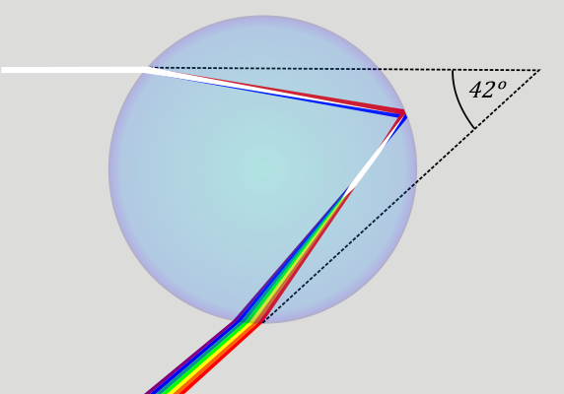
Droplet Size Inferred from Rainbows
We see rainbows when rain drops are present, but not against clouds
Why not? Still spherical droplets with refractive dispersion
the same geometry works
Problem is diffraction: λ/D is too small
washes out pattern
Rainbow width is about 1°, or 0.017 radians
need λ/D >> 0.02 to wash out pattern
D << 50λ ≈ 25 μm

Slide 23
Multiple Approaches Penetrate the Fog
The cloud examples illustrate the value of multiple approaches
corroborate understanding
Bring to bear loads of common-sense observations
many of us already know these things, even if we didn’t think we did
Helps to ask yourself what range of direct experiences you have with the matter at hand
what handles can you invent?

Slide 24
Is 100 MPG from gasoline possible?
At freeway speeds, mainly fight drag: F_{d} = ½ρc_{D}Av²
ρ = 1.2 kg/m³, c_{D} ≈ 0.3, A ≈ 2.5 m², v = 30 m/s
F_{d} ≈ 400 N
Rolling resistance is about 0.01mg ≈ 100 N (indep. of v)
Net 500 N
A gallon of gasoline (3 kg × 10 kcal/g × 4.18 kJ/kcal) contains about 130 MJ of energy
Used at ~25% efficiency in internal combustion engine
W = F×d → d = 30 MJ / 500 N = 60 km ≈ 35 miles
100 MPG from gasoline at freeway speeds is super-hard
need a factor of four improvement in drag piece, for instance

Slide 25
Corn Ethanol Or Bust
Let’s calculate how much land we need to replace oil
an Iowa cornfield is 1.5% efficient at turning incident sunlight into stored chemical energy
the conversion to ethanol is at best 30% efficient
assuming 1.4:1 ratio, and using corn ethanol to power farm equipment and ethanol production itself
growing season is only part of year (say 50%)
net is 0.23% efficient (1.5% × 30% × 50%)
need 40% of 10²⁰ J per year = 4×10¹⁹ J/yr to replace petroleum
this is 1.3×10¹² W: thus need 6×10¹⁴ W input (at 0.23%)
350 W/m² summer insolation, need 2×10¹² m², or (1,400 km)² of land
that’s a square 1,400 km on a side; as a lower limit

Slide 26
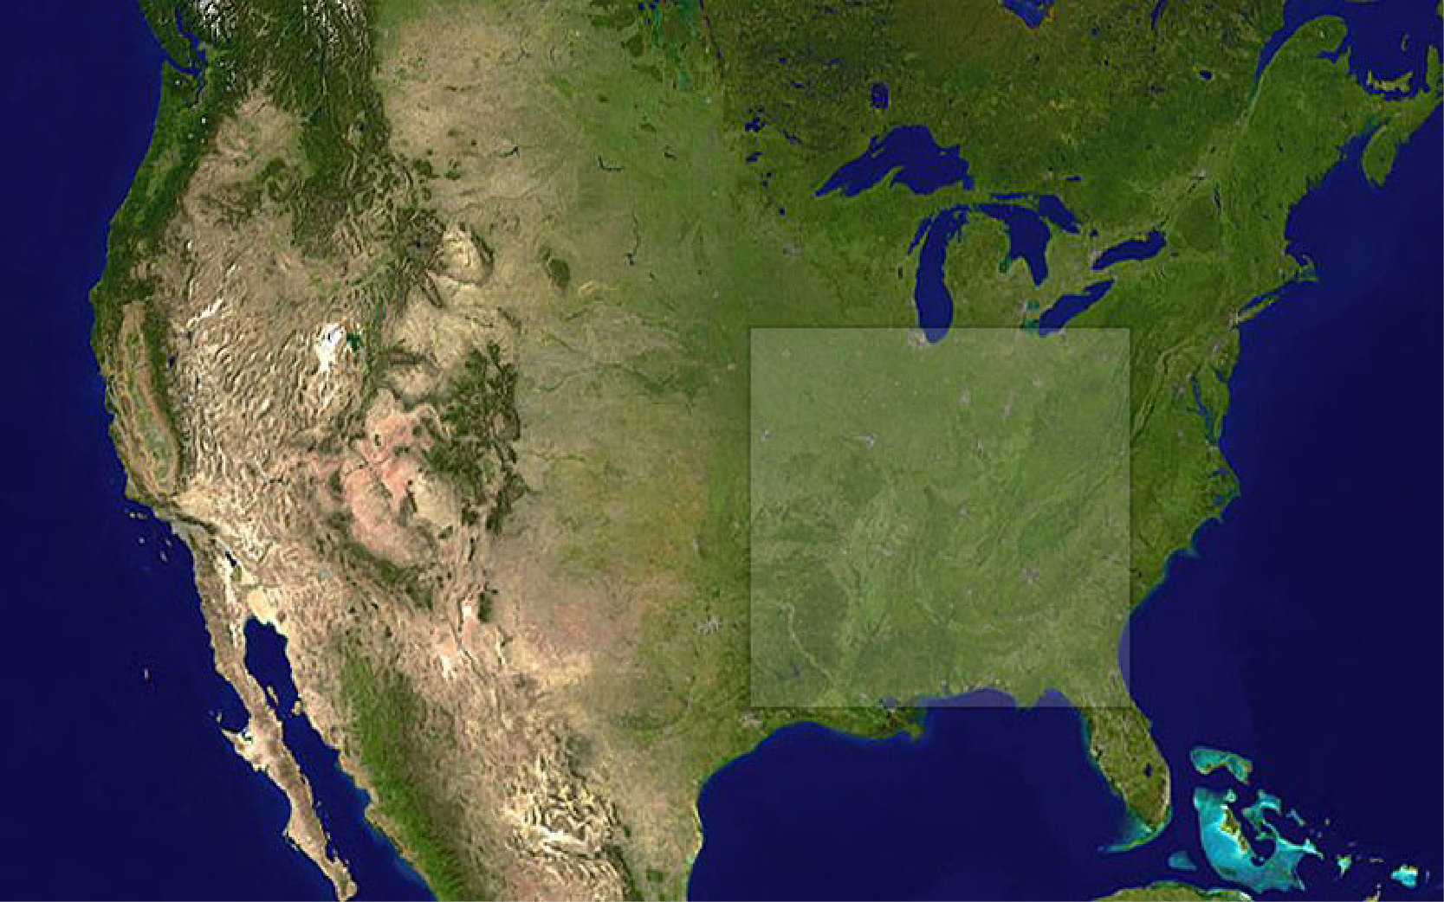
What does this amount of land look like?
We don’t have this much arable land!
And where do we grow our food?

Slide 27
Wasted Energy?
A recent article at PhysOrg touted a methane reclamation scheme from sewage in the L.A. area
Quotes from within article:
“This is a paradigm shift. We’ll be truly fuel-independent and no longer held hostage by other countries. This is the epitome of sustainability, where we’re taking an endless stream of human waste and transforming it to transportation fuel and electricity. This is the first time this has ever been done.”
“a third of all cars on the road in the U.S. could eventually be powered by ‘biogas,’ made from human waste, plant products and other renewable elements.”

Slide 28
Do the Math
Human metabolism is about 2000 kcal/day ≈ 100 W
We’re pretty good at extracting metabolic energy from food
let’s be generous and say we forfeit as much as 10% in our poop
that’s 10 W per person
In the U.S., we each consume 10,000 W of continuous energy
40%, or 4,000 W is from oil
60% of this, or 2,400 W, is imported
So we could at most expect to replace 0.4% of our foreign oil by powering our cars with human waste

Slide 29
Energy Storage
A major transition away from fossil fuels to solar, wind, etc. will require massive storage solutions
The cheapest go-to solution for stand-alone systems has been lead-acid batteries
but national battery would be a cubic mile, and require more lead than is estimated to exist in global resources (let alone proven reserves)
We can use estimation techniques to evaluate possible solutions
focus on home-scale solutions
scale will be 100 kWh of storage (3 days elec. for average American)
explore gravitational, batteries, compressed air, flywheels

Slide 30
Gravitational Storage
Hoisting rocks or pumping tanks of water: low tech approach
A rechargeable AA battery (1.5 V, 2 A-h → 3 Wh ≈ 10 kJ)
Hoisting mass on 3 m derrick: need 300 kg to match AA battery
gravitational storage is incredibly weak
100 kWh, in menacing 10 m high water tower, needs 3600 m³
15 meters on a side
oops

Slide 31
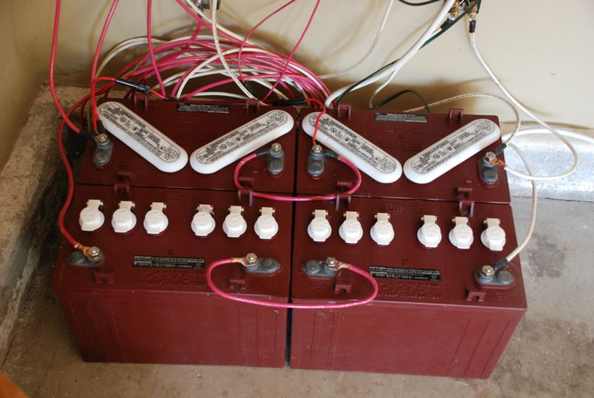
Lead-Acid Batteries
Each reaction involves a Pb atom in the anode, a PbO₂ molecule in the cathode, and two electrons at 2 eV each
100 kWh (3.6×10⁸ J) needs 10²⁷ Pb atoms
1700 moles; 355 kg of lead; might guess 4× realistic
real batteries would have 1500 kg of lead (2500 kg total battery mass)
2500 kg at 2.5× density of water → 1 cubic meter
will cost $15,000
actually, the cheapest, most compact of the four we’re considering
For U.S. to go full solar/wind requires significant storage
not enough lead in world resources (let alone reserves) to build for U.S.

Slide 32
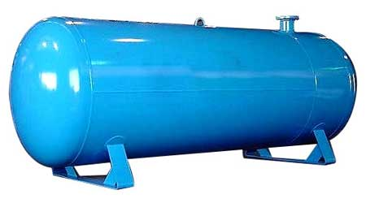
Compressed Air
Charged to 200 atm, energy is P₀V₀ln(P_{f}/P₀) = 5.3P₀V₀
simple integration of PdV = NkT(dV/V)
P₀ = 10⁵ Pa
Need 5.3×10⁵V₀ = 100 kWh = 3.6×10⁸ J
V₀ = 700 m³
V_{f} = 3.5 m³
cube 1.5 meters on a side

Slide 33
Flywheel
Solid cylinder: I = ½MR²
Edge velocity, v → ω = v/R; E = ½Iω² = ¼Mv²
Pick edge velocity v = 300 m/s
Need 16 ton mass
At density of steel, this is 2 cubic meters
e.g., 2 meters high; 1.2 meter diameter
acceleration at edge; v²/R is 16,000g
break-up: exceeds mechanical strength
need larger, slower to be safe: 2.5 m diameter, 125 m/s
10 m³; 80 tons → 1250g
can get 25 kWh
unit 2×3 m; $100k

Slide 34
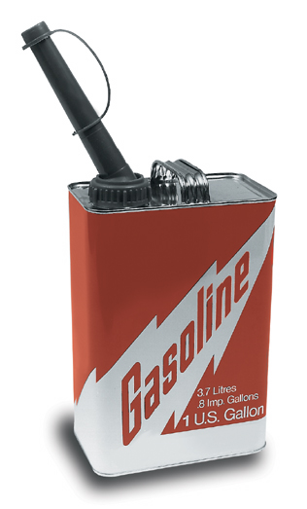
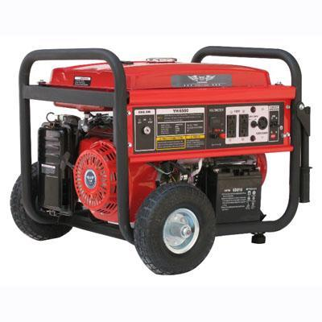
Heck: Just use a generator!
Each gallon of gasoline contains 36.6 kWh of thermal energy
Home Depot generator probably 15% efficient
seems like the rest comes out in noise!
about 5 kWh of electricity per gallon
For 100 kWh, need 20 gallons (75 liters) of gasoline
gasoline: 0.075 m³
lead acid: 1.0 m³
compressed air: 3.5 m³
flywheel: 10 m³
water/grav at 10 m: 3600 m³
Hard to beat fossil fuels!

Slide 35
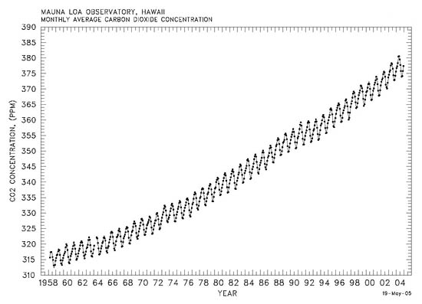
The Rise of CO₂
2.4 ppm/yr
380 ppm = 380 parts-per-million = 0.038% by volume
1.85 ppm/yr
reference
Charles Keeling (SIO), started measuring atmospheric CO₂ from Mauna Loa in
Hawaii in 1958. Besides the annual photosynthetic cycle, a profound trend is seen.

Slide 36
Is this rise surprising?
Every gram of fossil fuel used produces 3 grams of CO₂
it’s straight chemistry: to get the energy out via combustion, the carbon from the hydrocarbon gets attached to oxygen and off it goes
How much should we expect?
global energy budget is 4×10²⁰ J/yr; pretend all from fossil fuels
average 10 kcal/gram → ~40,000 J/gram → 10¹⁶ g/yr F.F.
so 3×10¹⁶ g/yr CO₂ → 3×10¹³ kg/yr CO₂
atmosphere has mass = 5.3×10¹⁸ kg → CO₂ adds 5.7 ppm/yr by mass
about 3.7 ppm/yr by volume (CO₂ is 44 g/mol vs. 29 for air)
50/50 to ocean/atmosphere, atmospheric rise is 1.85 ppm/yr, by volume
this is darn close to what we see on the “Keeling curve” graph

Slide 37
Total CO₂ rise
We can do the same thing for the entire fossil fuel history
have gone through 1 trillion barrels of oil → 140 Gtoe
Gtoe is gigaton (10⁹ ton) oil equivalent (by energy)
used about 160 Gtoe coal worldwide
using 40 Gtoe U.S. times four, since U.S. uses 25% of world energy
used 1037 tcf natural gas in U.S. → 27 Gtoe, so guess 100 Gtoe worldwide
400 Gtoe of fossil fuels → 1.2×10¹⁵ kg of CO₂ (3× FF mass)
228 ppm of atmosphere by mass; 150 ppm by volume
half into atmosphere → 75 ppm increase
see 100 ppm increase (280 ppm pre-industrial to 380 ppm)
So the CO₂ increase is absolutely expected!

Slide 38
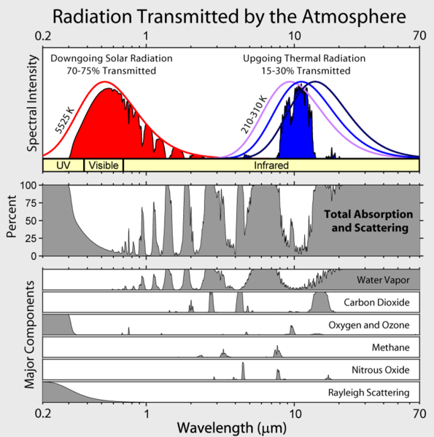
Expected Temperature Rise
If you add to the blanket, expect to get warmer
Applying σT⁴ in radiative equilibrium, Earth is 255 K
but actual number is 288 K, thanks to 33 K greenhouse effect
How much warmer?
We know that 7°C of the 33°C greenhouse effect is from CO₂
Have gone from 280 to 385 ppm (11/8 times as much, or 3/8 increase)
This should translate into 7°×3/8 = 21/8 = 2.6°C change
but takes some time because oceans are slow to respond, having enormous heat capacity
Should be NO SURPRISE that burning loads of fossil fuels makes us warmer
not actually hard to understand!

Slide 39
Summary
We often know more than we think about a problem
Real world problems don’t come with tidy numbers attached
Estimation and multiple techniques often fruitful
Every congressperson should have an estimator on staff
and LISTEN to them!

